Slide 1

Welcome Year 6

Slide 2
Welcome
Teachers: Miss Haynes, Miss Ayers, Mrs Edwards and Miss Elwin

Slide 3
Support staff
Learning Support Assistants:
Mrs Moolachery
Mrs Rawling
Miss White (am)
Mrs Naughton (Cover Supervisor)
Our Learning Mentor is Mrs Lane
They support the learning experiences of all children but often have a focused role to take with individuals who need specific forms of support and guidance.

Slide 4
What will our school day look like?
Arrive at school prior to Registration. School gate opens at 8:30
8:30 to 8:45: Morning Work
8:40: Registration
8:45 Lessons begin
10.30-10.45: Break time for toilet / healthy snack
10.45-12.15: Lesson time
12.15-1.15: Lunch
1.15-3.00: Lesson time
3:00: Home time

Slide 5
Some of the areas of learning in Year 6
Autumn Term 1:
History: What was the impact of World War 2 on the people on Britain?
Science: Evolution and inheritance
Autumn Term 2:
History: What was the impact of World War 2 on the people on Britain?
Science: Light and reflection
Spring Term 1:
Geography: Where does our energy come from?
Science: Classifying big and small
Spring Term 2: Why does population change?
Geography: Science: Circuits, batteries and switches
Summer Term:
History: The Sikh Empire
Science: Circulation and health

Slide 6

PSHE
As a school, we have bought into a new
PSHE programme backed by the NHS.
This programme is called myHappymind.
Running alongside the in school lessons, a parent
app is available that helps you support your child.

Slide 7
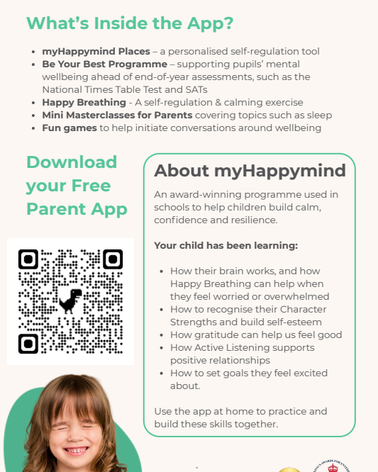
PSHE
QR code.

Slide 8
Some of the areas of learning in Year 6
Holdenby House Trip: Wednesday 25th November 2027
SATs week: Monday 10th – Thursday 13th May 2027

Slide 9
What are the uniform expectations?
All pupils must wear the full and correct Haydon Abbey school uniform. We have two uniforms; a standard unifom and a PE uniform for PE days.
Please label all items with your child’s name.
- Dark grey skirt, pinafore dress or long dark grey school trousers
- A white, button-up shirt with a collar
- Haydon Abbey jumper/cardigan
- Kameez (optional) - dark grey
- Hijab - one piece - royal blue, if worn
- Haydon Abbey Fleece (outdoor wear - optional)
- White or grey socks
- Black shoes only - high heels and boots are not permitted

Slide 10
What are the P.E uniform expectations?
To be worn on PE days only and in the event of extreme hot weather when notified.
PE uniform
Light blue t-shirt / school PE top Navy PE jumper Navy joggers Navy shorts – just above the knee Trainers (only on PE days)

Slide 11
Uniform-
Other points to note about the expected standards.
Stud earrings only (must be removed or taped prior to a PE lesson or at home. Own tape to be provided)
No nail varnish
No makeup
No over-sized hair accessories such as JoJo bows
No jewellery such as necklaces, bracelets
No smart watches
Long hair must be tied back
PL Schoolwear: Unit 1. Goodchild Parkway Sir Henry Lee Crescent Aylesbury Bucks HP180PE
Pre-loved uniform is available at reduced prices from the PTA. A form is available online and should be emailed to pta@haydonabbey.bucks.sch.uk or by hand to the main school reception. Orders are on a first come first serve basis and will be dependent on availability.

Slide 12
PE Days
PE Days for Year 6 are as follows:
Wednesday
Friday

Slide 13
What do my children need to bring?
A named water bottle every day- not just when the weather is warm
Hat/sun cream if the weather is warm
Wet weather clothes on wet weather days so we can still go outside
Reading Record, they will need to bring this every day too.
Lunch box – to include an ice pack in warm weather (if not school dinner)
A named pencil case with the following items of stationery:
  Several blue biros
  Several HB pencils
  Rubber, sharpener, a ruler with cm and mm
  A glue stick
  Colouring pencils

Slide 14
What do I need to bring to school each day in Year?
Healthy snack for break
Fruit
Raw veg (carrot, pepper, cucumber etc.)
Crackers (non salt based)
No items that contain nuts
Please could items be placed into a named reusable container

Slide 15
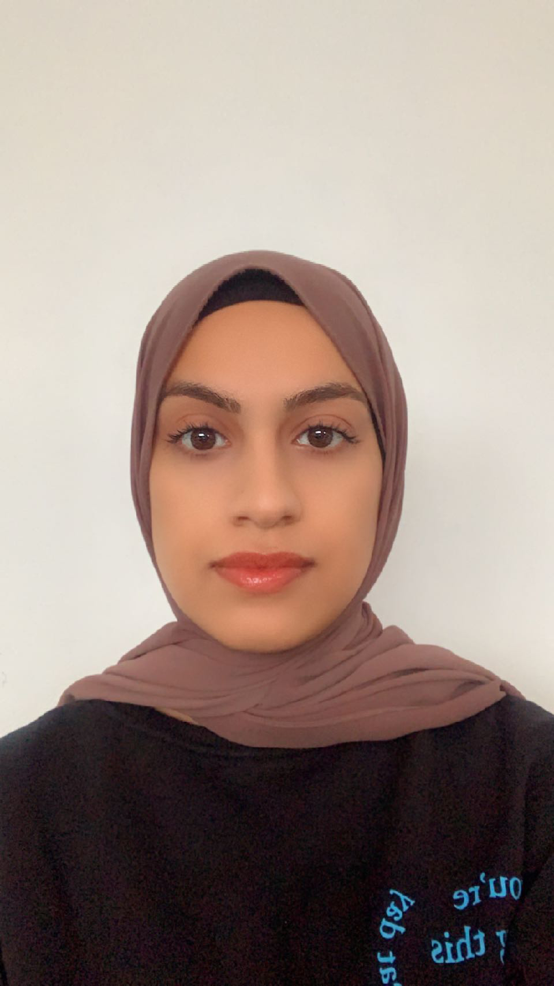
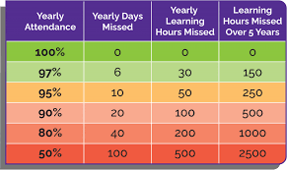
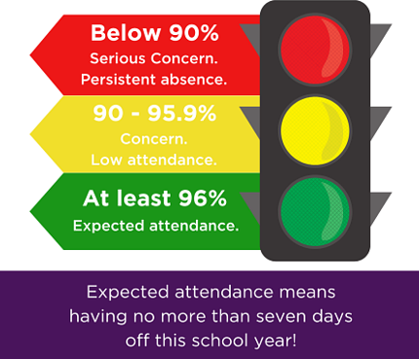
Attendance
Our Family Support worker, Miss Sheikh, works with all children and families to ensure that they are attending school and able to access the learning that they are entitled to, in order to reach their full potential. Any time off can really affect a child’s education.
pupilabsence@haydonabbey.bucks.sch.uk
Absences must be notified, to this email address, everyday of absence before 9.00 am. This is a statutory requirement for safeguarding purposes.
Any sickness and diarrhea - 24 hours after the last bout.
Holidays during term time are always unauthorized and may lead to a fine from county.

Slide 16
Travelling to and from school:
There is very limited parking and Haydon Abbey promotes a ‘Walk to School’ policy.
Where this is not possible, parents and carers can park in the Sainsbury’s carpark and walk over to collect children.
Please do not try to park near the school. It is a very busy residential area and parking safety is not possible.

Slide 17
Homework
Once we are settled back into school in September, we will have weekly homework. The homework book contains a combination of Maths and English work that will help to consolidate learning or provide pupils with an opportunity to pre learn topics prior to a unit of work.
Reading to an adult / monitored by an adult- recording their reading at least 4 times per week in their Reading Record.
Spelling words – taught in school, issued to revise for a spelling test within a week. Your child will be given a spelling record. New spellings are given out each Friday and returned the following Friday.
Workbooks are used for English and Maths. Children must present their work neatly, using a blue biro for English and a pencil for all Maths work.
TT Rockstars (5 minutes per day)
Homework will usually be set on Fridays and be due in on Wednesdays. There will be the opportunity to attend Homework Club for support with home learning.

Slide 18

Behaviour Expectations
3 key principles that will be used by all staff to set expectations and discuss behaviour

Slide 19

Ready- children
Wear the correct school uniform
Arrive at school and lessons on time
Sit according to the seating plan they have been given
With support assess if they are ready to enter the classroom and learn
Settle quickly to learn

Slide 20

Respectful- children
Listen carefully to the teacher, visitor or classmate who is talking
Take care of the equipment, resources and facilities in our school
Speak respectfully to others in school avoiding aggressive, foul or abusive language
Respect the rights of everyone to access the learning opportunities

Slide 21

Safe- children
Keep their hands and feet to themselves and don’t intentionally hurt others
Follow the instructions of adults in relation to safety in school
Act as positive roles model in the school corridors and classrooms
Inform school staff of any concerns they have for their own or others’ wellbeing
Understand that everyone has the right to feel safe in our school

Slide 22
Walking to and from school
Many Year 5 and Year 6 pupils have parental permission granted to walk to school and home from school.
With permission, these pupils may bring a mobile phone with them (in case of emergencies during the journey). These phones are kept by the teacher during the school day.
The permission form needs completing for the year ahead if you want them to walk home after school. If there is no permission to walk, we cannot let them leave school unless they are accompanied by a parent or nominated adult.

Slide 23

After School Club

Slide 24
Medications
Asthma inhalers should be brought to the school office with instructions of when/how to administer.
Epipens – make sure there are two epipens in school.
If your child has any other conditions you wish the school to be aware of, please feel free to discuss with your child’s class teacher

Slide 25
What parents can do
Help the children develop an increasing level of independence over time
  High expectations
  Good bed time routine
  Limit and monitor screen and internet use
Support, encourage, share, guide
Show that we all are part of applying the school rules and expectations for the good of the children
  Standards
  Uniform
  Healthy diet and snacks
  Homework
  Attitudes to learning
  Support and promote the shared values and ethos of the school
  Support your child to develop emotional literacy using the Zones of Regulation as a guide
  Be a role model of respectful behaviour to all within our school community
  Promote good attendance
  Communicate appropriately with the school and staff team

Slide 26
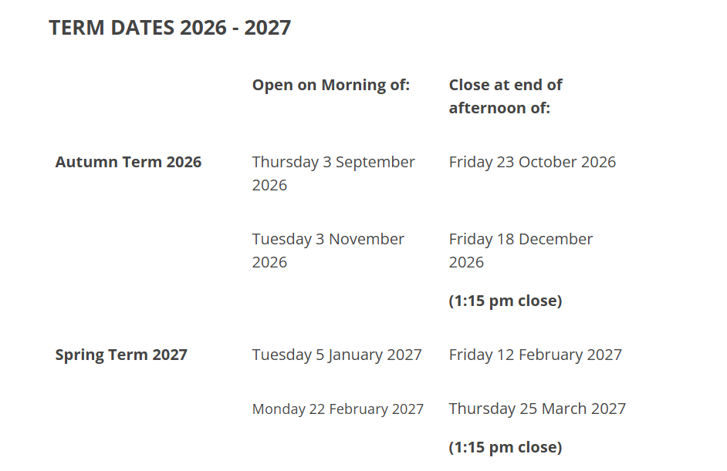
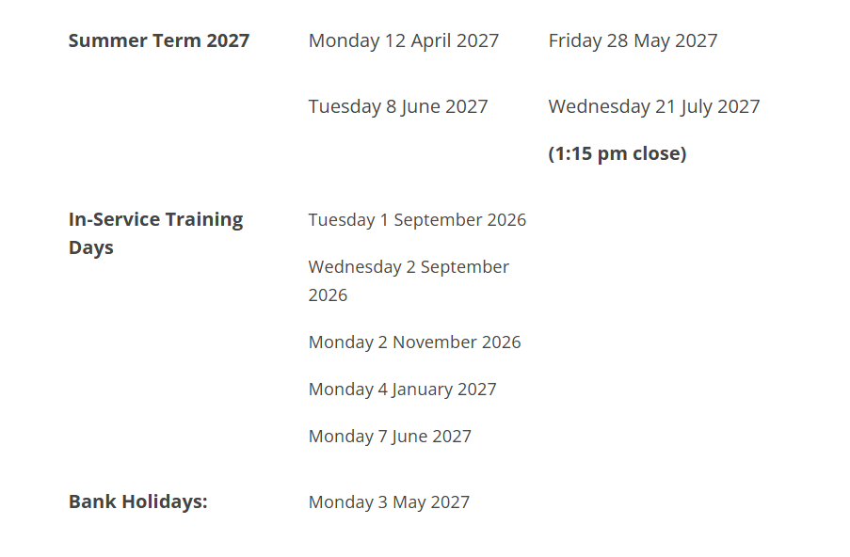
Dates for your diary

Slide 27

Volunteering
The school always needs volunteers, whether it be with listening to readers, supervising on school trips or something else. If you would like to volunteer please take a volunteer application form the main office and return once collected.

Slide 28
How to contact us
Absence email address- pupilabsence@haydonabbey.bucks.sch.uk
Main office- office@hayonabbey.bucks.sch.uk
Telephone: 01296 482278
Asheikh@haydonabbey.bucks.sch.uk
Speak with class teacher at the end of the school day
Family worker- Pastoral support, Asheikh@haydonabbey.bucks.sch.uk
SENCO- senco@haydonabbey.bucks.sch.uk

Slide 29

Any questions

Slide 30
Thank you for coming

