Slide 1
Phonics and Reading Workshop
23rd November
2017

Slide 2
Early Reading
Why is reading important?
Reading opens the door to learning and to the world around us. It underpins everything we do and is essential to our everyday lives.
Developing an early interest in reading for your child, not only paves the path for their school successes, but also life.
The beginning of your child’s reading journey started a long time before they joined the school and you were and continue to be their role models!
Notes:
2

Slide 3
Promoting a love of reading
Before worrying about reading levels, get your child hooked on books!
Take trips to the library together and read a story together each day. Ignite a love of reading and the reading attainment will follow.
Ensure that they are immersed into a text rich world, where you promote the importance of the printed word. Explore letters/words on logos, shop names, food packets, etc.
Show that there is a book for all interests. If your child is truck mad then tap into this interest through books!
The more you read, the more things you will know. The more that you learn, the more places you’ll go! – Dr Seuss.
Notes:
3

Slide 4
Reading requires two skills:
De-coding and word recognition
Comprehension.
Comprehension:
- Being able to read does not mean you understand what you read.
- Your child might sound like a good reader but may not necessarily understand or be able to discuss what is happening in the text.
- The best way to develop understanding is to talk about texts.
Notes:
4

Slide 5
- Before reading a book together, always talk about the title, the pictures and the information on the cover (front and back). If it’s new, ask what your child thinks the book might be about. If it’s an old favourite then talk about the bits you love most! Don’t worry if some books get chosen again and again!
- During reading, ask the children to predict what might happen next. What will happen next? Why do you think that? Were you right?
- Talk about the stories and information books when you’ve finished reading together and ask questions. What did you like best? How did Mum feel when Floppy knocked over the vase? Is your school like Kipper’s school? Get your child to ask you questions too.

Slide 6
How to enjoy school reading books together.
- Choose a quiet time away from the distraction of technology.
- Make reading an enjoyable experience!
- Sit with your child to show that you value this time together and to stress its importance.
- Try not to pressurise them if they are reluctant. Think of another way to engage them.
- If your child loses interest, then have a break and do something else. You don't want them seeing reading as a chore that they start to resent doing.
- Remember that children need to experience a variety of reading materials e.g. picture books, comics, magazines, poems, information books, recipe books etc. If your child loses interest in reading a school book, grab their attention another way and pull out a comic to read together!
- Try not to become frustrated with your child's reading. This will only upset you both and demoralise your child.
- Be patient. If there is a word that your child is struggling with, then come back to it afterwards. Write it down on a post it note/piece of paper to remember for later. Don't give in and tell them straight away or they become reliant on your help. Try to balance the support you offer.
- If it is a long book, don't worry about finishing it in one night. Take your time. Short bursts of quality reading can be just as effective as plodding through an entire book.
- Read alternate pages with your child so that they can see that you are enjoying the book too. It also gives them the chance to help you with any words that you find tricky ;0)
- Don't focus just on the reading of words. Use the pictures in the book to re-tell the story without reading. Get your child to predict what might happen next or come up with an alternative ending together. Discuss your child's favourite part or character. Can they think of another story that has these characters in or has any similarities?
Notes:
6

Slide 7
What do we do in school to continue to develop these early reading skills?
The children in the Foundation Stage class are exposed to a ‘print-rich’ environment of signs, labels, books, key words, displays and role play areas that give opportunities for reading, all of which the children are encouraged to notice and learn to read. There is a reading corner where the children can enjoy sharing and listening to during story time.
Daily phonics teaching
Shared reading
Story time
Individual reading

Slide 8
How does Phonics work?
Phonics focuses on sounds rather than, for example, having children try to recognise whole words.
In analytic phonics, words are broken down into their beginning and end parts, such as ‘str-‘ and ‘eet’, with an emphasis on ‘seeing’ the words and analogy with other words.
In synthetic phonics, children start by sequencing the individual sounds in words - for example, ‘s-t-r-ee-t’, with an emphasis on blending them together.
Once they have learned all these, they progress to reading books.
The ‘synthetic’ part comes from the word ‘synthesise’, meaning to assemble or blend together.

Slide 9
Letters and Sounds
which consists of six phases.
Phase 1 Nursery
Phase 2 - 4 Reception
Phase 5 – 6 KS1

Slide 10
Phase 1
There are 7 aspects to Phase 1.
Aspect 1: Environmental
Aspect 2: Instrumental sounds
Aspect 3: Body Percussion
Aspect 4: Rhythm and rhyme
Aspect 5: Alliteration
Aspect 6: Voice sounds
Aspect 7: Oral blending and segmenting.

Slide 11
Enunciation
Teaching phonics requires a technical skill in enunciation.
Phonemes should be articulated clearly and precisely.

Slide 12
Phase 2
s | a | t | p
Set 1:
Set 2:
Set 3:
Set 4:
Set 5:
i | n | m | d
g | o | c | k
ck | e | u | r
h | b | f | ff
l | ll | ss

Slide 13
Phase 3
Set 6:
Set 7:
Consonant digraphs:
Vowel
digraphs:
j | v | w | x
y | z | zz | qu
ch | sh | th | ng
ai | ee | igh | oa
oo | ar | or | ur
ow | oi | ear | air | er | ure

Slide 14
Phase 4
This phase consolidates all the children have learnt in the previous phases.

Slide 15
Phase 5
Children will be taught new graphemes and alternative pronunciations for these graphemes.
Vowel
digraphs:
Split
digraphs:
wh | ph | ay | ou
ie | ea | oy | ir
ue | aw | ew | oe | au
a-e | e-e | i-e | o-e | u-e

Slide 16









Rainbow Words

Slide 17
Segmenting
Breaking down words for spelling.
cat
c a t

Slide 18
Segmenting
queen
qu ee n

Slide 19
Blending
Building words from phonemes to read.
c a t
cat

Slide 20
Blending
qu ee n
queen

Slide 21
Blending
I went to the shops to get a sand/wich

Slide 22
What does a Phonics lesson look like?
Part of the Lesson | Type of Activity
1. Revisit/Review | Revise previous days learning GPCs and blending and segmenting – assess!
2. Teach | New GPC or Rainbow word is introduced – show the GPC and practise saying the sound and blending and segmenting in words.
3. Practise | Practise blending and reading words with a new GPC. Practise segmenting and spelling words with a new GPC.
4. Apply | Ensure children have the opportunities to hear/say/read/write the phoneme/grapheme. Build up to read or write a caption or sentence using one or more tricky words and words containing the graphemes as the children progress through the phases.

Slide 23
Early Learning Goal
Children use their phonic knowledge to write words in ways which match their spoken sounds. They also write some irregular common words. They write simple sentences which can be read by themselves and others. Some words are spelt correctly and others are phonetically plausible.
Children read and understand simple sentences. They use phonic knowledge to decode regular words and read them aloud accurately. They also read some common irregular words. They demonstrate understanding when talking with others about what they have read.

Slide 24
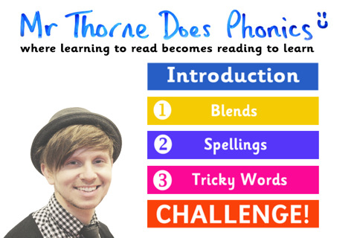
Resources
Mr Thorne Does Phonics
You Tube
App

Slide 25
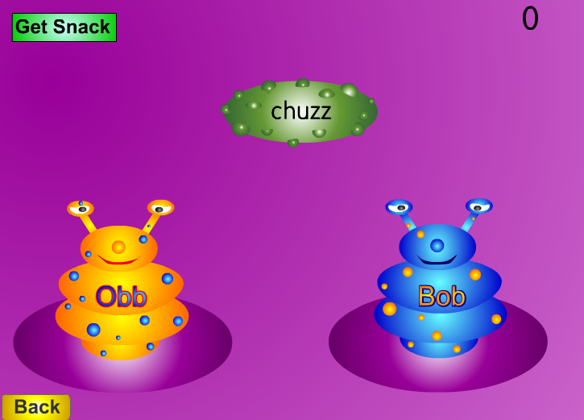
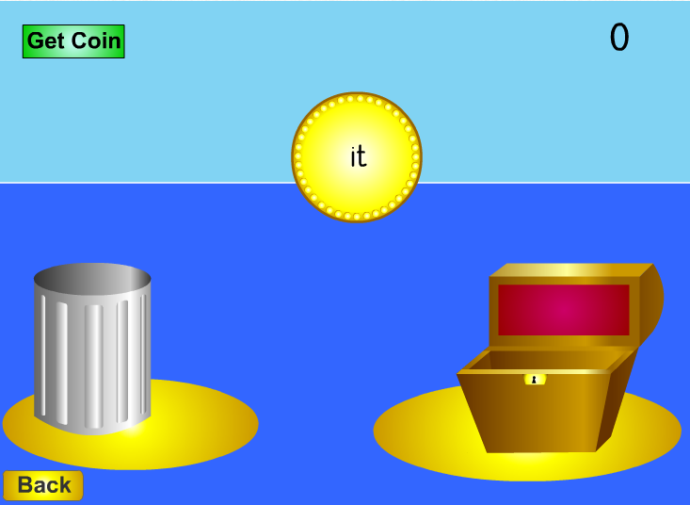
Resources
http://www.phonicsplay.co.uk

Slide 26
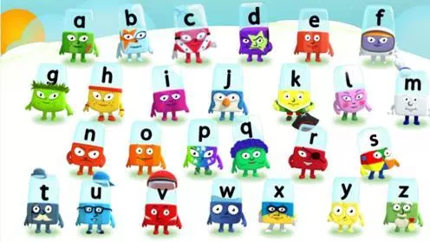
Resources
Alphablocks on Cbeebies
Learning in disguise!

